Slide 1
Stress Orientation Rotation of the 2018 Mw 7.5 Palu Earthquake

Slide 2
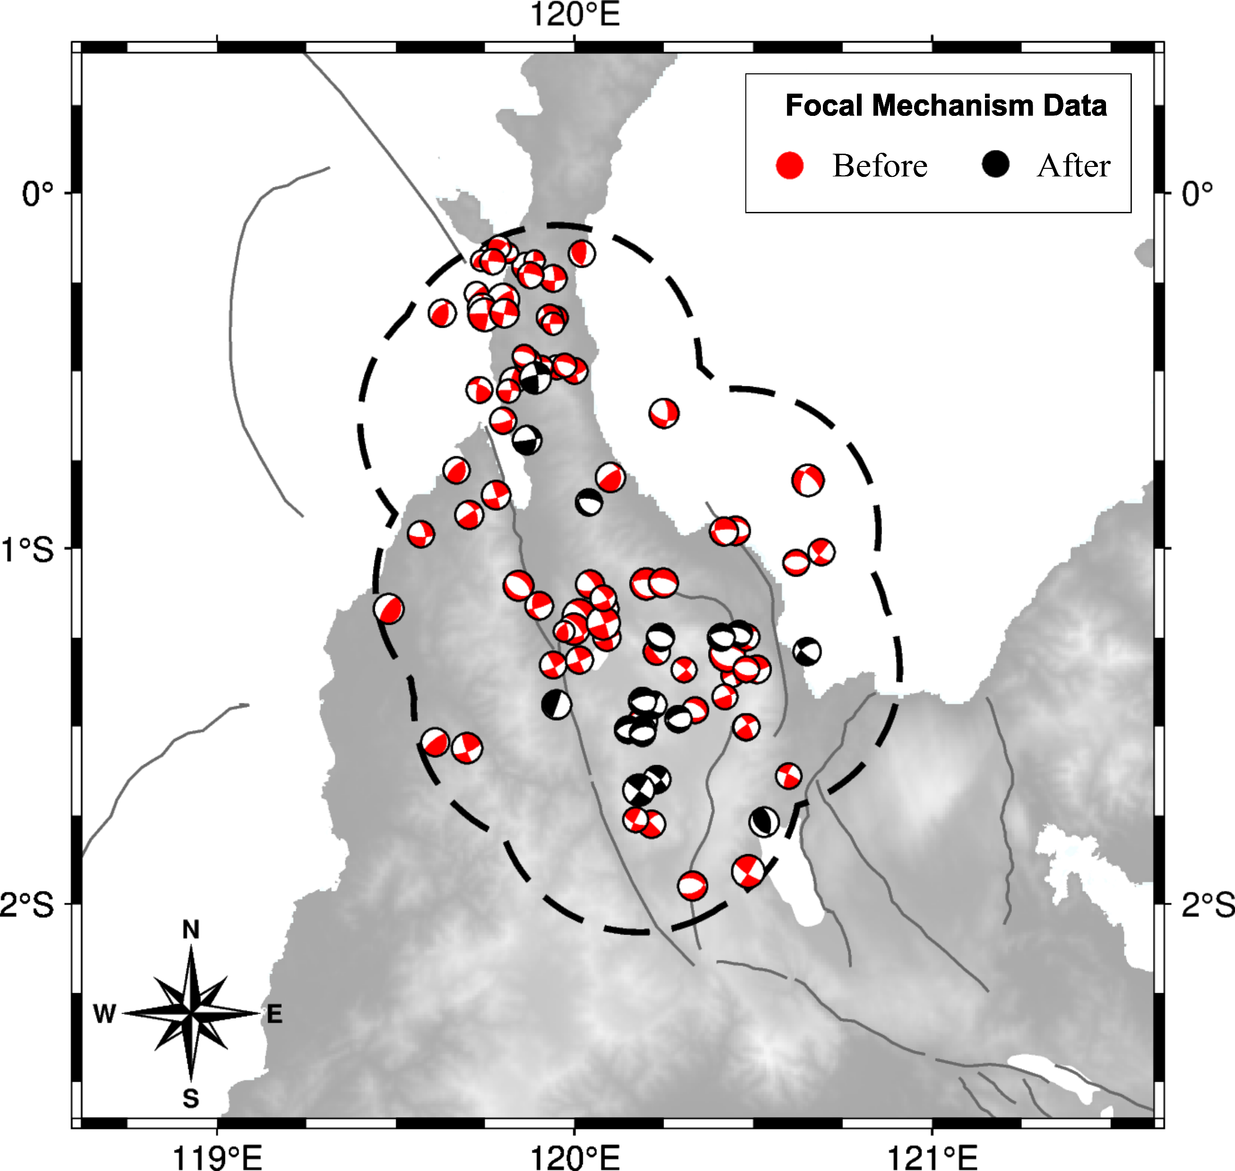
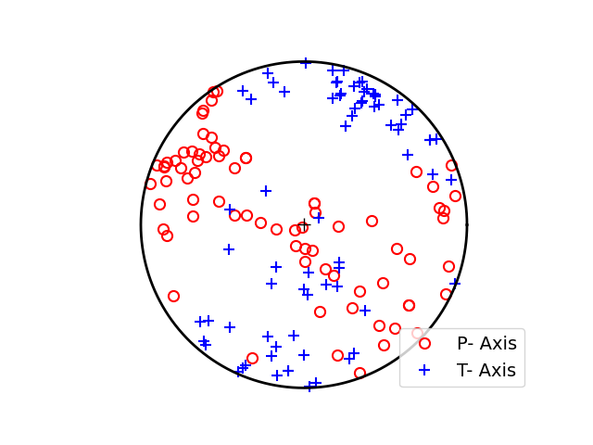
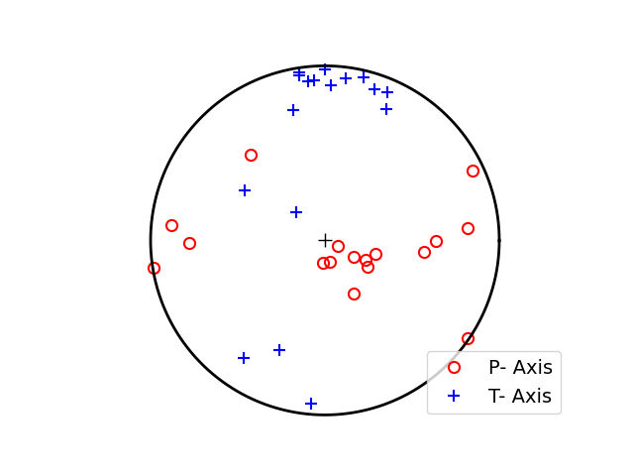
Focal Mechanisms Data
Before 2018 Mw7.5 Palu
76 events
May 1977 – Sep 2018
After 2018 Mw7.5 Palu
17 events
Sep 2018 – Nov 2021

Slide 3
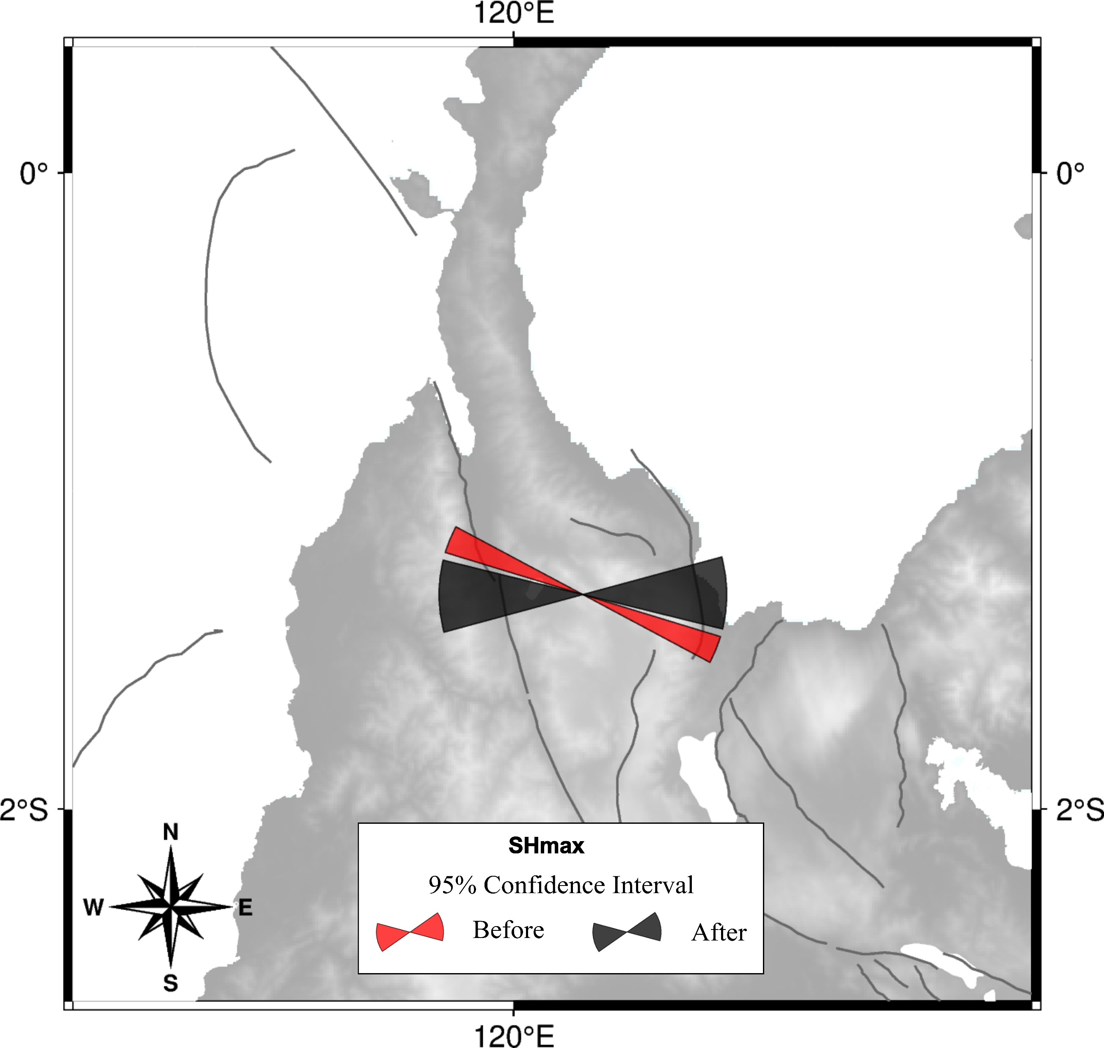
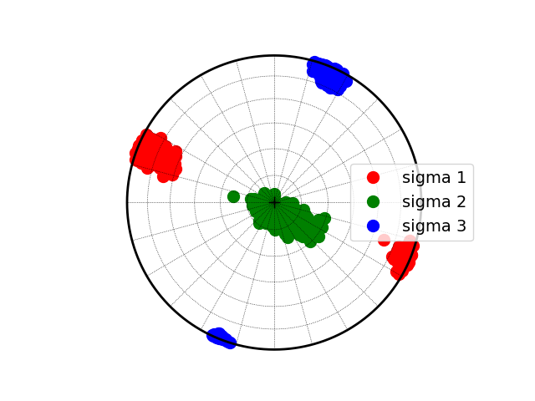
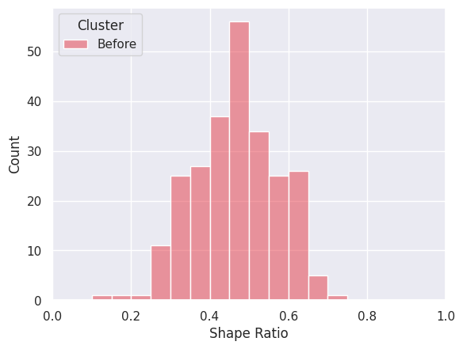
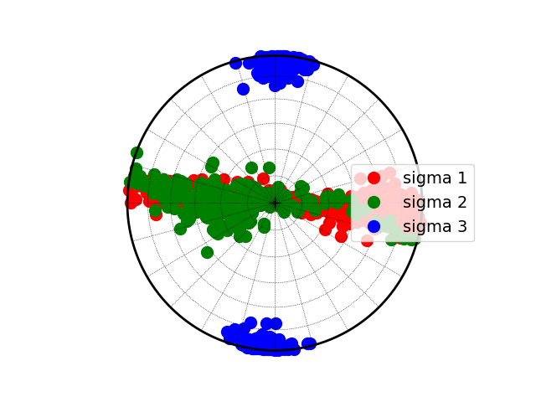
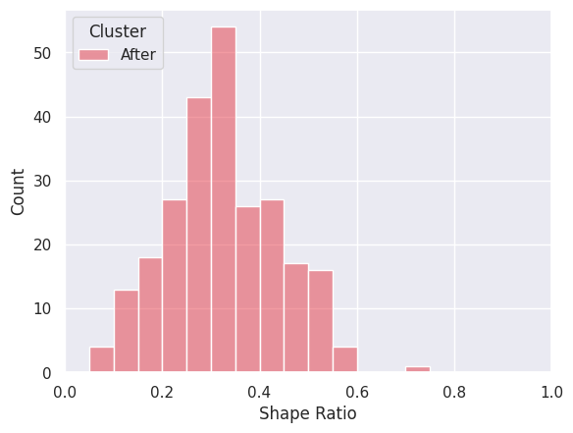
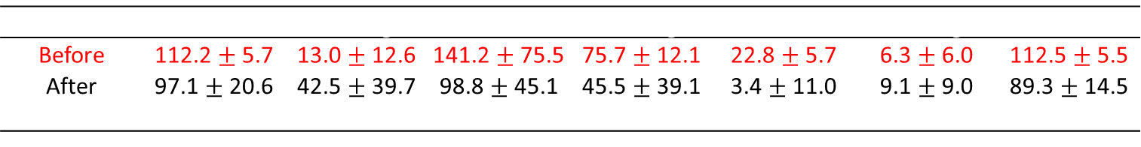
Stress Inversion Result
Before 2018 Mw7.5 Palu
After 2018 Mw7.5 Palu
 | $$σ1 Azimuth$$ | $$σ1 Plunge$$ | $$σ2 Azimuth$$ | $$σ2 Plunge$$ | $$σ3 Azimuth$$ | $$σ3 Plunge$$ | SHmax
Before | 112.2 $±$ 5.7 | 13.0 $±$ 12.6 | 141.2 $±$ 75.5 | 75.7 $±$ 12.1 | 22.8 $±$ 5.7 | 6.3 $±$ 6.0 | 112.5 $±$ 5.5
After | 97.1 $±$ 20.6 | 42.5 $±$ 39.7 | 98.8 $±$ 45.1 | 45.5 $±$ 39.1 | 3.4 $±$ 11.0 | 9.1 $±$ 9.0 | 89.3 $±$ 14.5
$$Δ$$ | -15.1 | 29.5 | -42.4 | -30.2 | -19.4 | 2.8 | -23.2

Slide 4

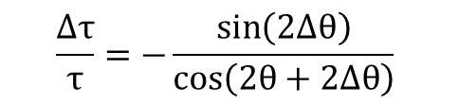
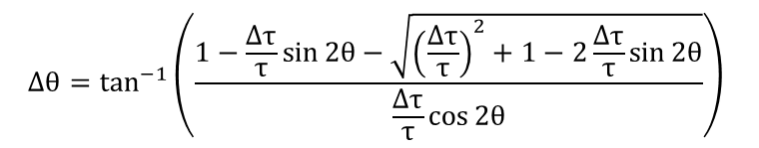
Stress Drop Ratio $\left(\frac{Δτ}{τ}\right)$ Calculation
To calculate the stress drop ratio, we use equation (4) in Hardebeck 2001
$$Δθ=\tan^{−1}\left(\frac{1−\frac{Δτ}{τ}\sin{2θ}−\sqrt{{\left(\frac{Δτ}{τ}\right)}^{2}+1−2\frac{Δτ}{τ}\sin{2θ}}}{\frac{Δτ}{τ}\cos{2θ}}\right)$$
$$\frac{Δτ}{τ}=−\frac{\sin\left(2Δθ\right)}{\cos\left(2θ+2Δθ\right)}$$

Slide 5
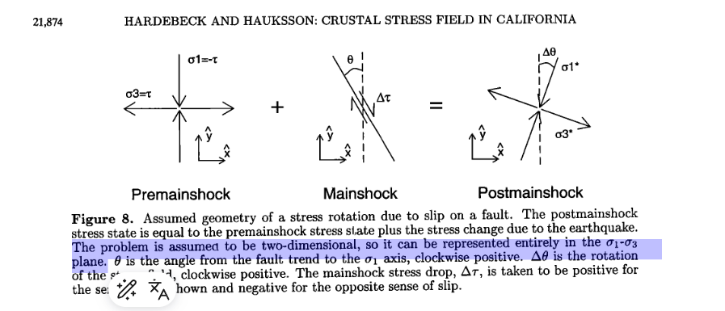
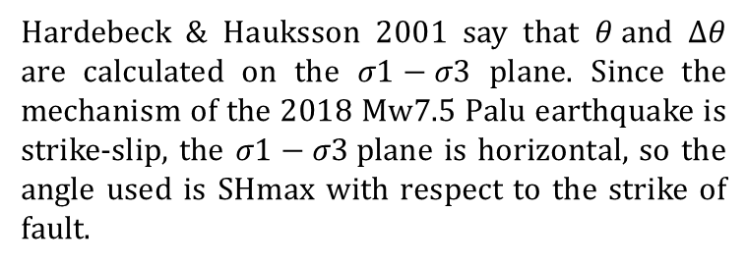

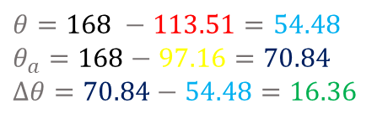

Calculation of $θ and Δθ$
Hardebeck & Hauksson 2001 say that $θ and Δθ$ are calculated on the $σ1−σ3$ plane. Since the mechanism of the 2018 Mw7.5 Palu earthquake is strike-slip, the $σ1−σ3$plane is horizontal, so the angle used is SHmax with respect to the strike of fault.
U
Nodal plane 2018 Mw 7.5 Palu
348$∙$57$∙$-15 87$∙$77$∙$-146
$θ=168 −113.51=54.48$
$θ_{a}=168−97.16=70.84$
$Δθ=70.84−54.48=16.36$
$$Fault | Before | After | θ+Δθ | θ | Δθ$$
S

Slide 6
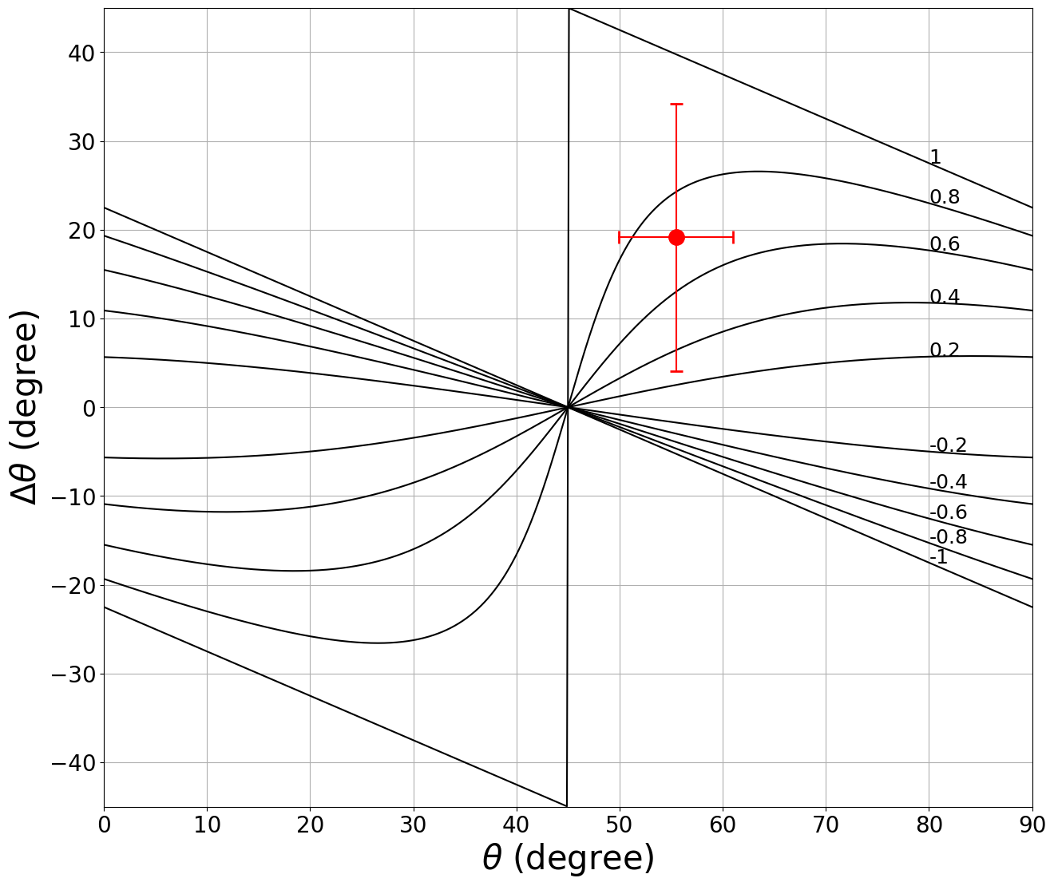
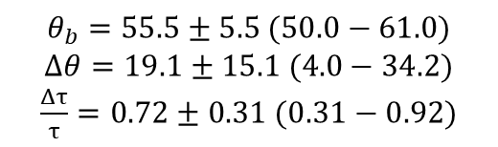
Model Stress Drop 2018 Mw 7.5 Palu by SHmax
$$θ_{b}=55.5±5.5 (50.0−61.0)$$
$$Δθ=19.1±15.1 (4.0−34.2)$$
$\frac{Δτ}{τ}=0.72±0.31 (0.31−0.92)$

